Slide 1

SEPTEMBER 11–13, 2017
BOSTON, MA
new tools for healthcare
ARE THEY RIGHT FOR YOU?
HealthcareSecurityForum.com/Boston/2017
#HITsecurity

Slide 2
New Security Tools
New security tools and technologies are going to change healthcare security the way we know it.

Slide 3

AI

Slide 4


Slide 5

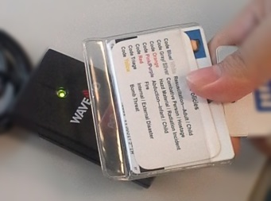
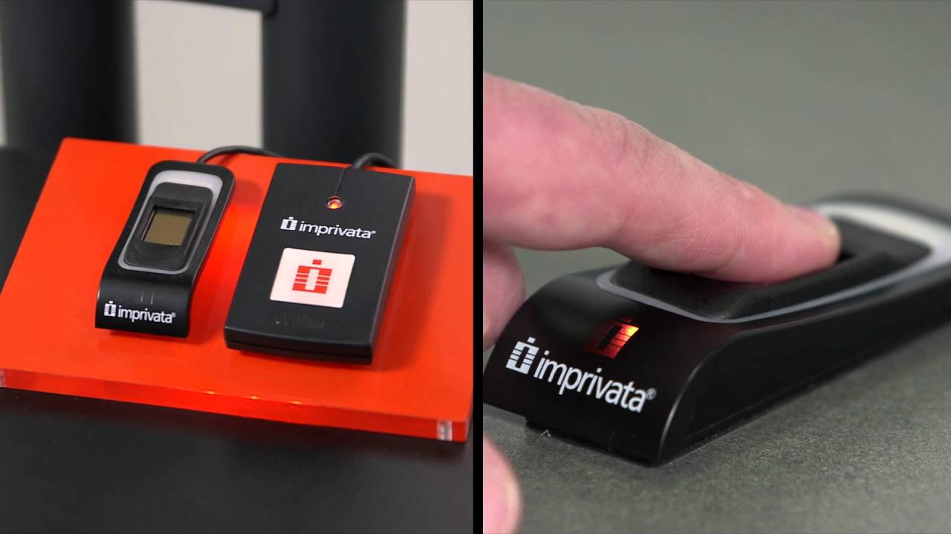

Biometrics & MFA

Slide 6



Slide 7

Big Data - Patient Diagnosis
Better Patient
Outcomes

Slide 8

Big Data - Security Analytics

Slide 9

Big Data - Security Analytics
Security Operations:
  Threat Intelligence
  Visibility & Telemetry
  Anomaly Detection
  User Behavior Analysis
  Detection and Response

Slide 10

Tools That Enable Security Segmentation
Information Technology
Operational Technology
IT
OT
Convergence

Slide 11

Isolate & Segment
Building Management Systems
& Third Party Vendors

Slide 12

Isolate & Segment
Legacy Medical Devices

Slide 13

Segmentation Improves
Patient Safety

Slide 14

Prevent the lateral spread of malware from reaching this guy

Slide 15

Segmentation
Slows IP Theft -
Clinical Research

Slide 16
Security Micro-Segmentation
Users
Objects
Data

Slide 17
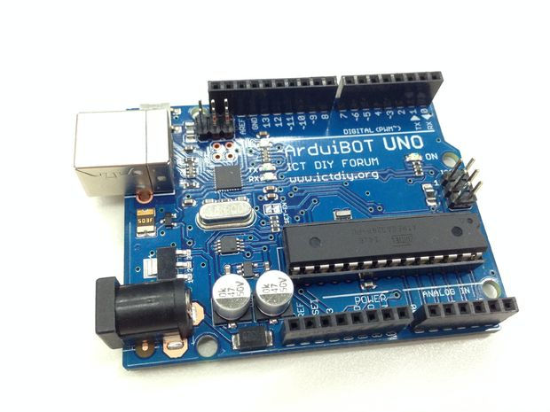
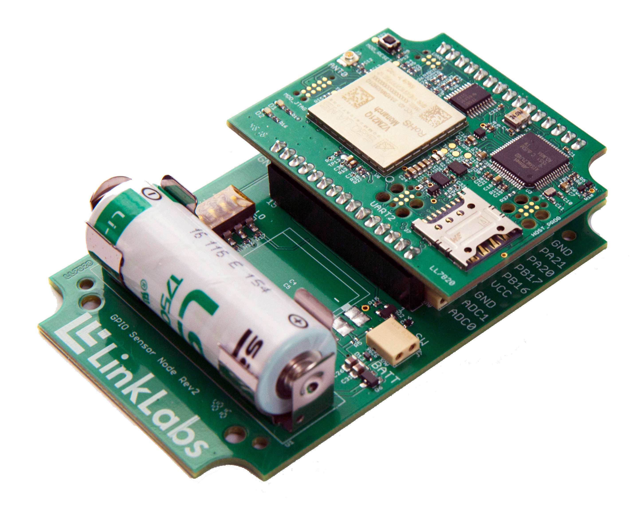
Compensating Security Controls for Insecure Endpoints
Even if devices arrive from a vendor with the following ports & protocols enabled:
TFPT
Telnet
FTP
SSH

Slide 18
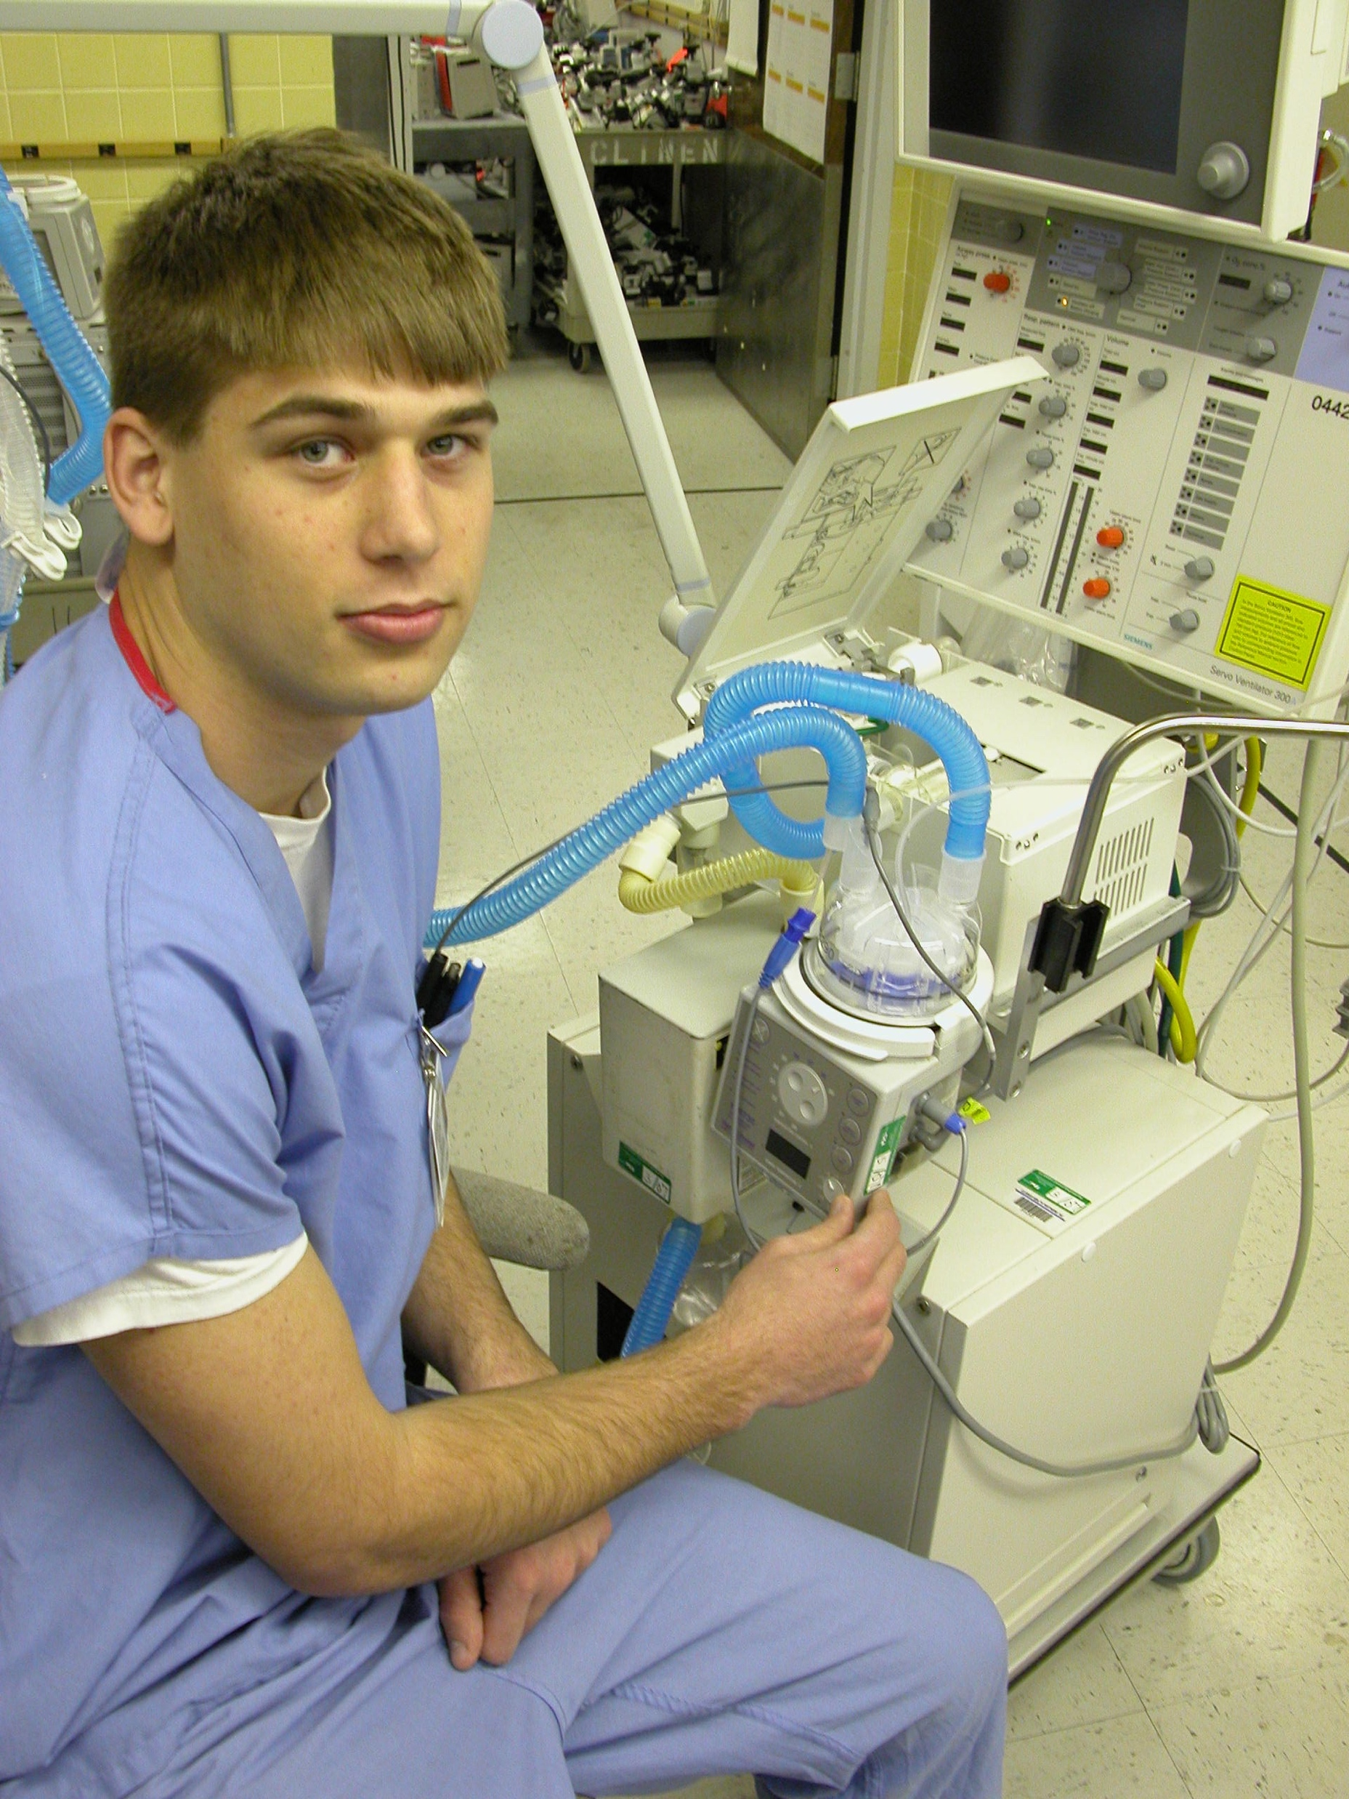
Who should be managing your medical devices?
This Guy?

Slide 19


Slide 20
New Tools
These are tools that boost automation, protection, visibility, and intelligence, leading to improved threat detection, prevention and containment of inevitable attacks.
But are they right for your organization?

Slide 21
Think Before You Jump
What Questions should you ask?
(((( SHOUT OUT! ))))

Slide 22
Time Is Not On Your Side
Average time to implement = 2~3 years
Average CISO tenure = 17 months
Will you ever see it completed?
Is that good for your resume?

Slide 23

Project Panacea
There is no point blowing all your budget on the world’s most secure front door if you can’t afford window locks!

Slide 24

Too Many Security Tools

Slide 25

Security Silos Complicate Protection
      Most hospitals have between 45 and 65 security vendors
      Most vendor systems don’t talk to each other!

Slide 26
20%

Slide 27
20%
That’s the average functionality used of the security tools you own
(and pay maintenance on each year)

Slide 28

Are You Reinventing the Wheel?

Slide 29

We Need to Consolidate to a Smaller, Leaner and more Manageable Toolbox.

Slide 30

We need to work SMARTER not HARDER

Slide 31

……….to Achieve Success

Slide 32
New Toys
‘Security is an industry where we are continually developing new solutions without understanding the problem we are trying to fix’.

Slide 33
New Toys
As you move into the next sessions what questions should you ask yourself?

Slide 34
Questions to Ask Yourself
What business benefits it will provide to the organization?
How will it impact Patient Care and Patient Safety?
How will it improve a Physician Workflow?
What business risk gaps will each tool address? (Business Justification)
What legacy tools it will retire? (You don’t want more to manage)
How easily can each tool be integrated into the existing infrastructure?
How long will it take to implement?
What are the Integration costs?
What is the TCO including staff training?

Slide 35
Richard Staynings
Cisco
@rstaynings
HealthcareSecurityForum.com/Boston/2017
#HITsecurity

